Slide 1

The Flask Web Application Framework
Python Web Server Development
Notes:
>> Welcome message.
>> Suggest that if not already installed, attendees should install Python on their devices. >> Set expectations/hope to be through presentation in 30 minutes, spend last 30 minutes developing an application.

Slide 2
Fast Facts about Flask
Flask originally was developed by Armin Ronacher as an April Fool’s joke but is now a serious project run by the Pallets community organization.
Flask and Django are the two most popular Python web frameworks.
The Flask source code has over 67k stars on GitHub.
Notes:
>> Read slide.
>> Ask if anyone is interested in the comparison between Flask and Django (substantial time loss if so, but should be fine).

Slide 3
Flask Vs. Django
Flask
Django
Good for APIs, prototypes, small apps,
very customizable, many extensions,
minimalist design, easy to learn
Good for administration, eCommerce,
many out-of-the box features,
boilerplate code, harder to learn
Notes:
SKIP UNLESS REQUESTED

Slide 4

Why Choose Flask?
I have repeatedly chosen to use Flask due to its minimalistic, but expandable design. I find that Django is often overkill, and Flask gives me the control I need without unnecessary boilerplate code and unwanted features. This is not to say that Django is a bad framework, I just find it to be overly-complex for my needs and overkill in its features.
Notes:
SKIP UNLESS REQUESTED

Slide 5

Flask Documentation
>> Maintained by the Pallets community organization
>> Has the following: >> Quickstart >> Tutorials >> API Referrence
>> Docs: https://flask.palletsprojects.com/
>> Source code: https://github.com/pallets/flask/
>> PyPI: https://pypi.org/project/Flask/
Notes:
>> Read slide. >> QR Code goes to Docs URL listed below.

Slide 6



Flask Dependencies by Pallets
Jinja
Werkzeug
Click
Template engine
>> Extensible templating engine for HTML code.
>> Allows Python-like code syntax, passing data from Flask server.
WSGI Toolkit
>> Base tools for Flask internal WSGI functionality.
>> Manually interact with Werkzeug on rare occasions.
CLI Toolkit
>> Used for server and debug consoles.
>> Elegant and very informative development console make Flask debugging very straightforward.
Notes:
>> Read slide (quickly, not intended for great detail).

Slide 7
Installation and Setup
To develop Flask web applications, you need:
>> A recent version of Python with pip.
>> A Python-compatible editor or IDE.
>> Flask installed (pip install flask OR pip3 install flask via terminal).
Notes:
>> Make sure Flask gets installed correctly.

Slide 8
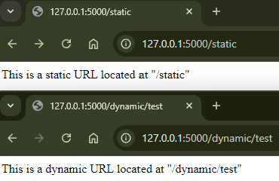
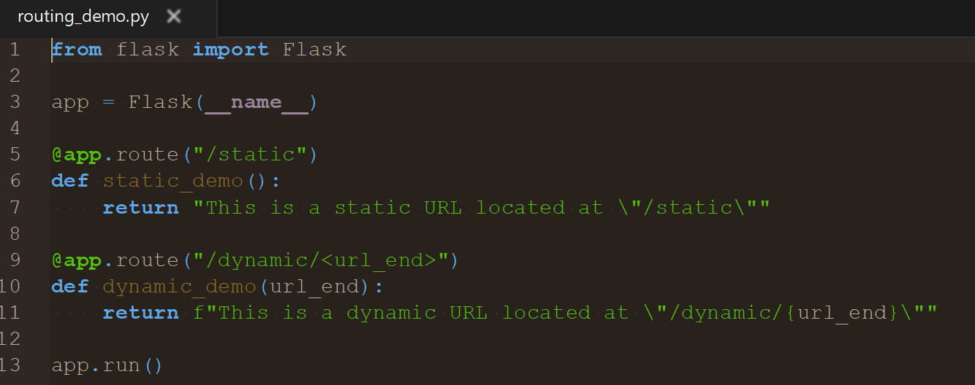
Flask Fundamentals Routes
A Flask application defines each URL on the site via a process called Routing. Routes within your application can take many forms and can even allow URLs to be dynamically processed by the server.
A route is generally defined by using the @app.route() decorator followed by the function with the route logic. This route logic function must return some data, which determines what the user sees.
Notes:
>> Read slide. >> Run through source code.
>> Take questions.

Slide 9
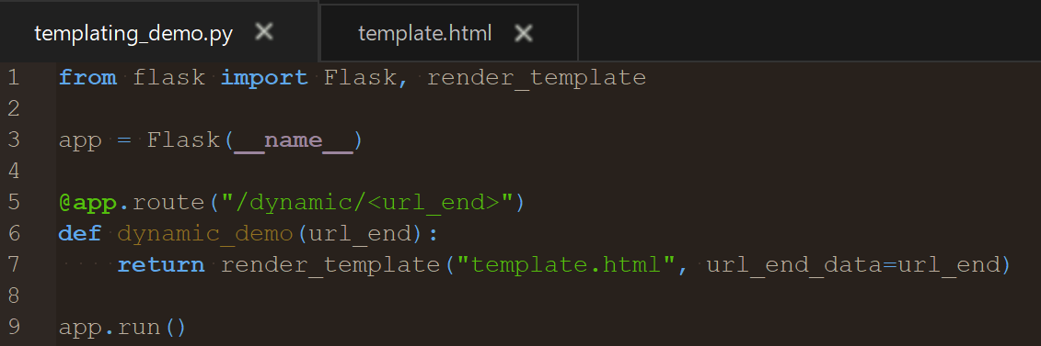
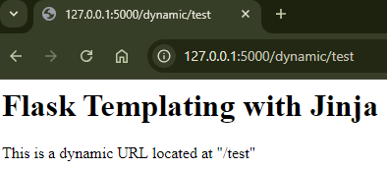
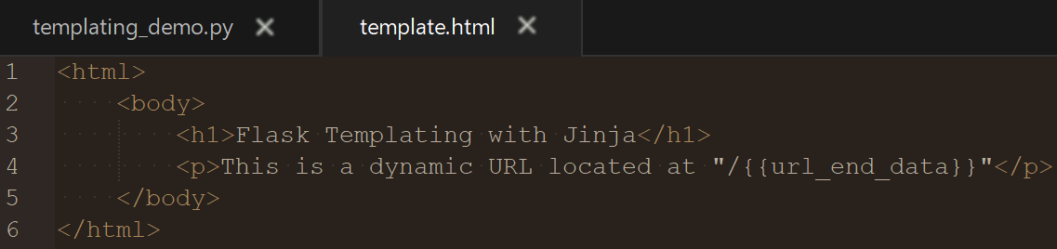
Flask Fundamentals Templates
What if you want a webpage to display dynamically-generated content, whether from a database or other source?
Jinja is a templating engine that comes with Flask and uses code written into Python and HTML files to allow the passing of values from the server’s route logic to the “template” HTML file.
The route logic’s return statement can return a call of Flask’s render_template() function, where the positional argument is the HTML file path in the “/templates” directory and any additional keyword arguments are passed on to Jinja and are accessed by “{{argument_keyword}}” in the template.
Notes:
>> Read slide. >> Run through source code.
>> Take questions.

Slide 10
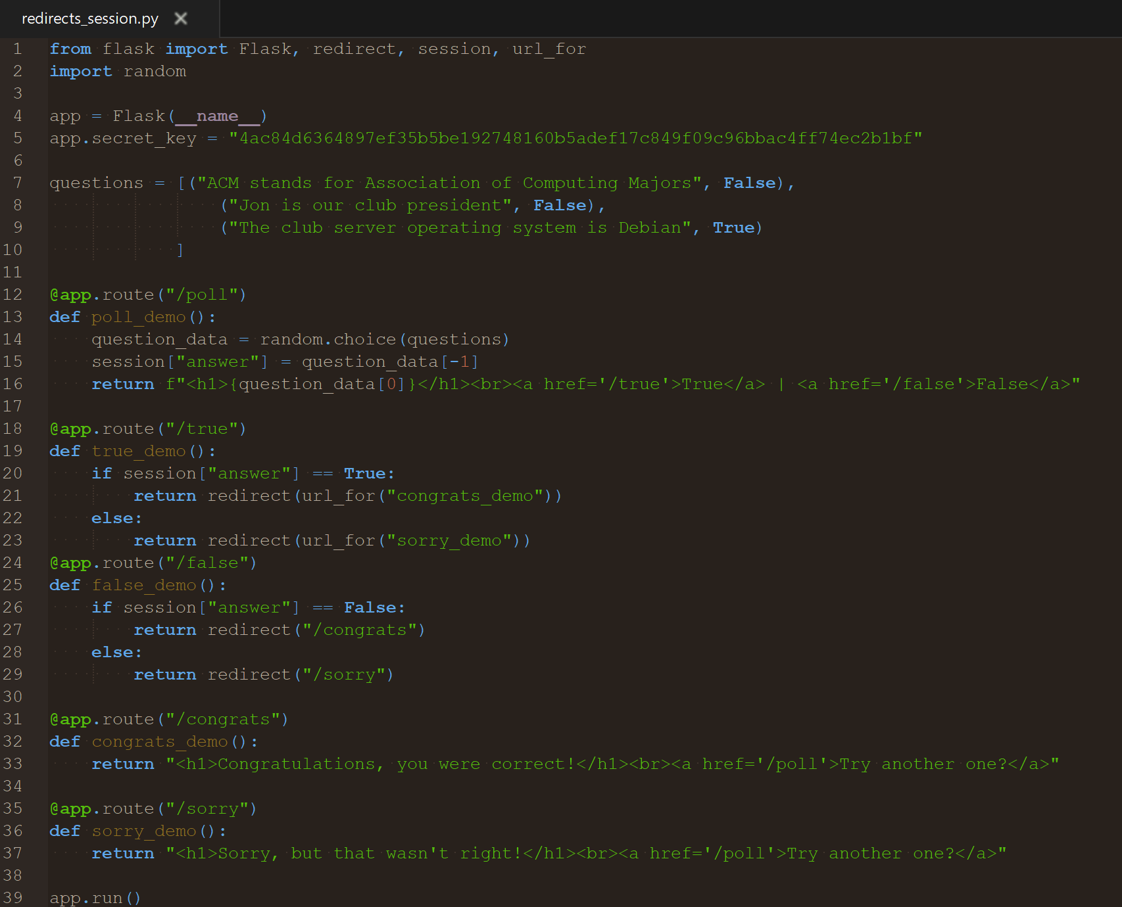
Flask Fundamentals Redirects & Session Data
Flask allows redirects to either specific URLs or, when combined with the url_for(“route_function_name”) method, to a specific function within your application route definitions.
One crucial aspect of many Flask applications is session data (encrypted cookies), which is implemented as a dictionary named “session” within the scope of the Flask application. This means that you can access data across multiple routes, but due to the cryptographic requirements of session data, you must set a secret key for the application.
Notes:
>> Read slide. >> Run through source code.
>> Live code demo of redirects_session.py.
>> Take questions.

Slide 11
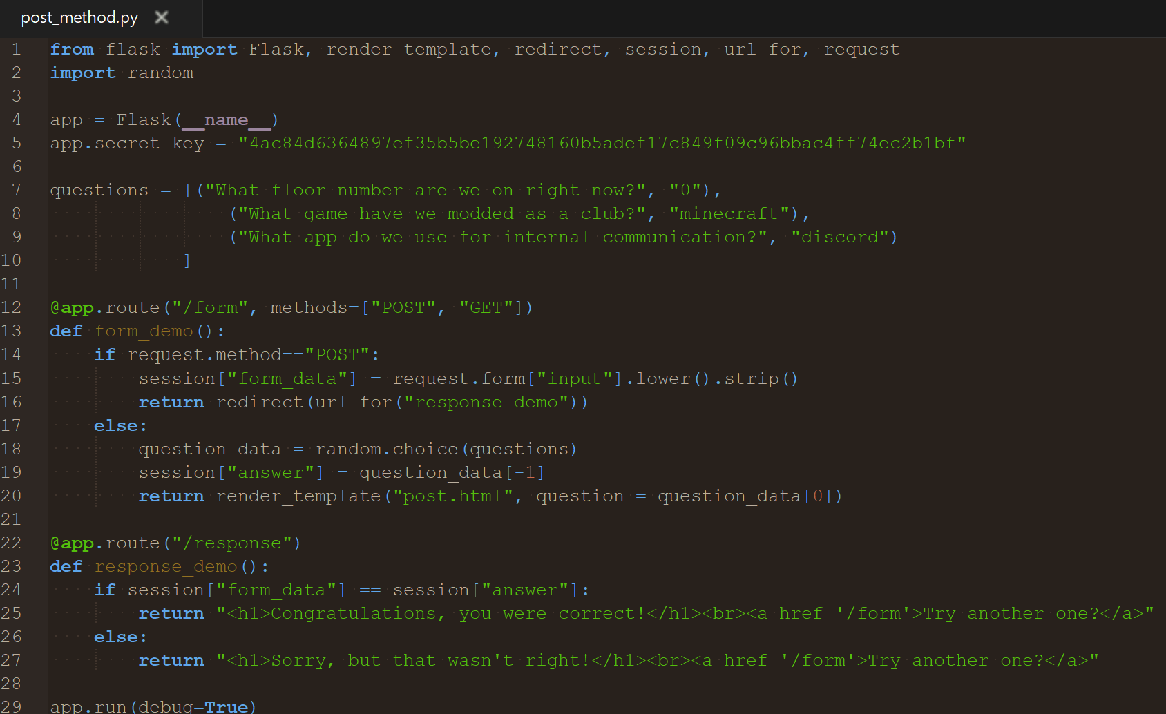
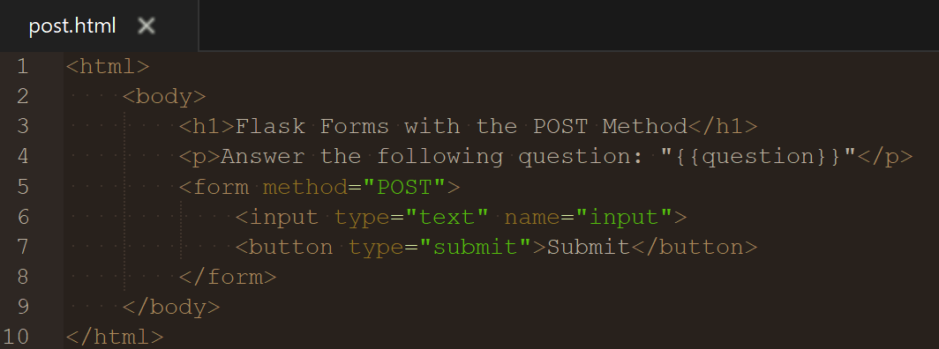
Flask Fundamentals The POST Method
While serving most webpages uses the “GET” request type, forms and other inputs (file uploads, API requests, etc.) often use “POST” instead. By default, Flask configures a route for “GET”, but “POST” must be added to the route manually. Once done, you can define separate logic for each request type using “request.method” in an if statement. Within the “POST” logic, you can access form fields from the “request.form” dictionary. Keep in mind that even with a “POST” request type, you must return either a redirect or page data to the user after processing the “POST” request.
Notes:
>> Read slide. >> Run through source code.
>> Live code demo of post_method.py.
>> Take questions.

Slide 12
More to explore
Flask is not limited to these aspects of web development – we’ve only covered the basics!
Flask’s documentation also covers:
>> Error handling & logging >> File uploads & downloads >> Pertinent documentation of Flask’s dependencies >> Suggested extensions >> Much, much more!
Notes:
>> Read slide (quickly, not intended for great detail).

Slide 13
Don’t Re-invent the Wheel
Flask-SQL-Alchemy
Popular and powerful SQL database extension
Flask-Login
Customizable and secure login manager
Flask-Mail
General-purpose wrapper for sending emails
Documentation
https://flask-sqlalchemy.readthedocs.io/en
https://flask-login.readthedocs.io/en/latest/
https://flask-mail.readthedocs.io/en/latest/
Notes:
>> Read slide (quickly, not intended for great detail).
>> Note that this is not an all-inclusive list of extensions.
>> Consider next slide (Hosting) based on time.

Slide 14
Deploying to Production
Self-Hosting
Cloud Hosting
Requires physical hardware for use as a server.
Process is documented online, may be challenging or time consuming.
No hardware required.
Some free trials/tiers of hosting are available, others require payment.
Process is usually well-documented and supported.
Notes:
>> Read slide (quickly, not intended for great detail).
>> Mention opportunities for hosting with club’s server.

Slide 15
Let’s Develop!
Let’s start building web apps with Flask during the time that remains this evening! I suggest you try to keep it simple for tonight (no permanent database, purely HTML pages, no Flask extensions) so we don’t get too overwhelmed.
Not sure what to start building? Maybe try to start building one of the following: >> Projects/portfolio website. >> Small business website. >> Multi-question quiz website.
Need help? >> Flask Documentation: flask.palletsprojects.com/ >> Demo Code: github.com/lefkovitzj/ACM-Flask-Presentation
As always, websites like StackOverflow can be helpful, and I’m happy to help as best I can!
Notes:
>> Read slide. >> Thank everyone for coming.
>> Start development with those who are interested.

